Slide 1
HTML (Hyper Text Markup Language)
Tip: Use graphics to set the tone of the speech.
Prepared By: Quratulain
Notes:
Be specific and direct in the title. Use the subtitle to give the specific context of the speech.
-The goal should be to capture the audience’s attention which can be done with a quote, a startling statistic, or fact. It is not necessary to include this attention getter on the slide.

Slide 2
Get started with HTML
Every webpage you look at is written in a language called HTML.
Hyper Text Markup Language: is the major markup language used to display Web pages on the Internet.
HTML is not a programming language; it is a markup language used to tell your browser how to structure the webpages you visit.
You can think of HTML as the skeleton that gives every webpage structure with help of tags (HTML elements).

Slide 3
HTML
HyperText Markup Language is the computer language that facilitates website creation.
The language, which has code words and syntax just like any other language, is relatively easy to comprehend and, as time goes on, increasingly powerful in what it allows someone to create.
HTML continues to evolve to meet the demands and requirements of the Internet under the guise of the World Wide Web Consortium, the organization that designs and maintains the language; for instance, with the transition to Web 2.0.

Slide 4
HTML(cont..)
HyperText is the method by which Internet users navigate the web.
By clicking on special text called hyperlinks, users are brought to new pages.
The use of hyper means it is not linear, so users can go anywhere on the Internet simply by clicking on the available links.
Markup is what HTML tags do to the text inside of them; they mark it as a specific type of text.
For example, markup text could come in the form of boldface or italicized type to draw specific attention to a word or phrase.

Slide 5
HTML (Cont..)
HyperText Markup Language (HTML) is the basic scripting language used by web browsers to render pages on the world wide web.
HyperText allows a user to click a link and be redirected to a new page referenced by that link.
Early versions of HTML were static (Web 1.0), while newer iterations feature a great deal of dynamic flexibility (Web 2.0, 3.0).
Markup is the text that appears between two pointed brackets (e.g., <footnote>), and content is everything else.

Slide 6
HyperText Markup Language – HTML
HyperText Markup Language (HTML) is the set of markup symbols or codes inserted into a file intended for display on the Internet. The markup tells web browsers how to display a web page's words and images.
Each individual piece markup code (which would fall between "<" and ">" characters) is referred to as an element, though many people also refer to it as a tag. Some elements come in pairs that indicate when some display effect is to begin and when it is to end.

Slide 7
Anatomy of HTML
The very first thing that you typically see in an HTML file is the DOCTYPE declaration.
<!DOCTYPE HTML>
The HTML document itself begins with <html> and ends with </html>
The visible part of the HTML document is between <body> and </body>

Slide 8
What Does a !DOCTYPE HTML Do?
The <!DOCTYPE html> declaration must be placed in the beginning of every HTML document: it informs the browser about the document type.
The very first line in every web document should contain a <!DOCTYPE html> declaration. Even though it's wrapped in angle brackets, it is not a tag but a statement.
Doctype stands for Document Type Declaration. It informs the web browser about the type and version of HTML used in building the web document. This helps the browser to handle and load it properly.
While the HTML syntax for this statement is somewhat simple, you must note each version of HTML has its own rules.

Slide 9
(cont..)
HTML5 <!DOCTYPE html> declaration is the simplest and shortest compared to those used by previous versions
Versions prior to HTML5 were based on Standard Generalized Markup Language (SGML), so their !doctype declaration had to contain a reference to their corresponding document type declaration (DTD).
This also meant saving the DTD declaration and having separate ones for strict and transitional modes.

Slide 10
HyperText Markup Language Basics
At its core, HTML is a series of short codes typed into a text-file. These are the tags that power HTML’s capabilities.
The text is saved as an HTML file and viewed through a web browser. The browser reads the file and translates the text into a visible form, as directed by the codes the author used to write what becomes the visible rendering.
Writing HTML requires tags to be used correctly to create the author’s vision.

Slide 11
The tags are what separate normal text from HTML code. Tags are the words between what are known as angle-brackets, which allow graphics, images, and tables to appear on the webpage.
Different tags perform different functions.
The most basic tags apply formatting to text.
As web interfaces need to become more dynamic, Cascading Style Sheets (CSS) and JavaScript applications may be used.
CSS makes web pages more accessible and JavaScript adds power to basic HTML.

Slide 12
Meta
<!doctype html>
<meta charset=utf-8>
Take a look at that <meta> tag very carefully. The first is that the <meta> tag is much shorter than that we have used up until now—we’ve been used to using
<meta http-equiv= ”Content-Type” content=”text/html; charset=UTF-8”>.
This is still possible, but the shorter way is preferred as it’s easier to type and works everywhere already
Notes:
Why such appallingly lax syntax? The answer is simple: browsers never cared about XHTML syntax if it was sent as text/ html—only the XHTML validator did. Therefore, favouring one form over the other in HTML5 would be entirely arbitrary, and cause pages that didn't follow that format to be invalid, although they would work perfectly in any browser. So HTML5 is agnostic about which you use.

Slide 13
HTML5 is not an XML language, so you don’t need to do those things. But you can if you prefer. All of these are equally valid
HTML5:
<META CHARSET=UTF-8>
<META CHARSET=UTF-8 />
<META CHARSET=”UTF-8”>
<META CHARSET=”UTF-8” />
<meta charset=utf-8>
<meta charset=utf-8 />
<meta charset=”utf-8”>
<meta charset=”utf-8” />
<MeTa CHARset=utF-8>

Slide 14
Anatomy of HTML Cont.
HTML consists of a series of elements, which you use to enclose, or wrap, different parts of the content to make it appear a certain way, or act a certain way.
<head> is also used to specify various kinds of information that is not shown on screen. So far it contains the title of the document, but later we will add the CSS style sheet there, too.
For example: <title> which specifies the title of the document and shows on the browser window.

Slide 15
<!doctype html>
<html lang=en>
<head>
<meta charset=utf-8>
<title>Interesting blog</title>
</head>
<body>
<p>Today I drank coffee for breakfast. 14 hours later, I went to bed.</p>
</body>
</html>
Notes:
While we’re on the subject of appallingly lax syntax rules (from an XHTML perspective), let’s cheat and, after adding the document title, we’ll go straight to the content: <!doctype html> <meta charset=utf-8> <title>Interesting blog</title> <p>Today I drank coffee for breakfast. 14 hours later, ¬ I went to bed.</p> If we validate this exhilarating blog, we fi nd that it validates fi ne, yet it has no <html> tag, no <head>, and no <body>

Slide 16
Example:
For example, take the following line of content:
My cat is very grumpy
If we wanted the line to stand by itself, we could specify that it is a paragraph by enclosing it in paragraph tags:
<p>My cat is very grumpy</p>
Web Engineering\first.html

Slide 17
Tags and elements
<p>Google's mission is to organize the world's
information and make it universally accessible and
useful.</p>
<p>Its founders Larry Page and Sergey Brin started
Google at Stanford University.</p>
</body>
</html>
<html>
<head>
<title>Popular Websites: Google</title>
</head>
<body>
<h1>About Google</h1>
<p>Google is best known for its search engine, although
Google now offers a number of other services.</p>

Slide 18
Separating Heads from Bodies
Whenever you write a web page in HTML, the whole of the page is contained between the opening <html> and closing </html> tags, just as it was in the previous example. Inside the <html> element, there are two main parts to the page:
The <head> element: Often referred to as the head of the page, this contains information about the page. (This is not the main content of the page.) For example, it might contain a title and a description of the page or instructions on where a browser can find CSS rules that explain how the document should look. It consists of the opening <head> tag, the closing </head> tag, and everything in between.

Slide 19
The <body> element: Often referred to as the body of the page, this contains the information you actually see in the main browser window. It consists of the opening <body> tag, the closing </body> tag, and everything in between

Slide 20
Starting on the first line, the first angled bracket looks like a less-than sign (<); then there are the letters “html,” followed by a second angled bracket, which looks like a greater-than sign (>). The two brackets and all the characters between them are known as a tag.
In this example, there are lots of tags, and they are all in pairs; there are opening tags and closing tags. The closing tag is always slightly different from the opening tag in that it has a forward slash (/) after the first angled bracket: </html>.
A pair of tags and the content these include are known as an element

Slide 21
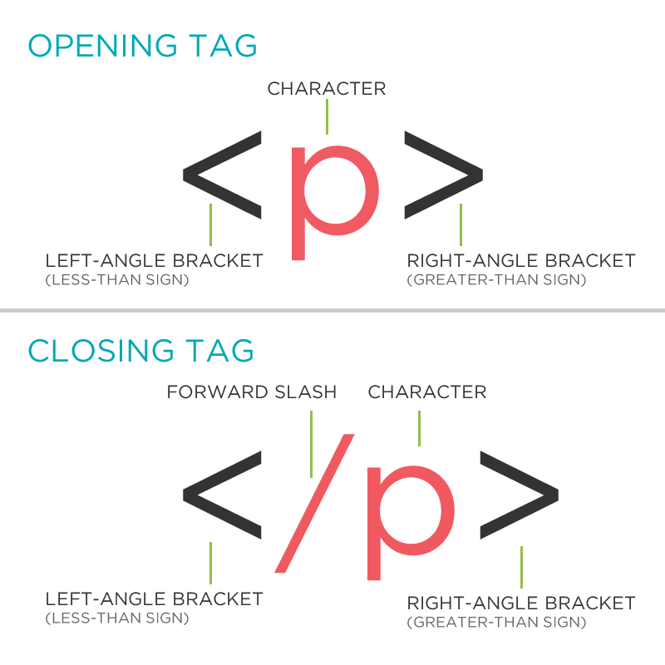
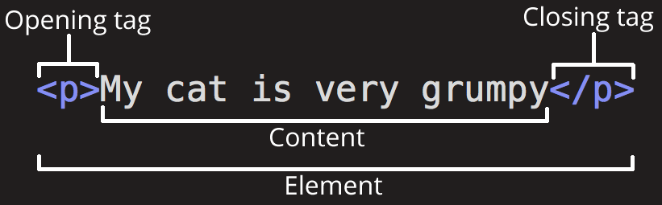

Slide 22
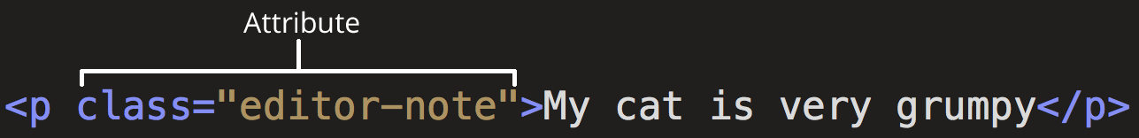
Elements can also have attributes, which look like this:
Attributes contain extra information about the element that you don't want to appear in the actual content.
Here, class is the attribute name, and editor-note is the attribute value. The class attribute allows you to give the element an identifier that can be later used to target the element with style information and other things.

Slide 23
If you want to have one element inside another, both the element’s opening and closing tags must be inside the containing element.
For example, the following is allowed:
<p> This paragraph contains some <em>emphasized text.</em></p>
whereas the following is wrong because the closing </em> tag is not inside the paragraph element:
<p> This paragraph contains some <em>emphasized text. </p></em>
In other words, if an element is to contain another element, it must wholly contain that element. This is referred to as nesting your elements correctly.

Slide 24
Attributes Tell You about elements
Attributes in HTML are much like the attributes you experience every day. They are the qualities that describe a person or thing, such as a tall man or a brown dog. Similarly, HTML elements can be described in ways that web browsers can understand.
Attributes are used to say something about the element that carries them, and they always appear on the opening tag of the element that carries them. Almost all attributes consist of two parts: a name and a value. The name is the property of the element that you want to set.
The value is what you want the value of the property to be.
The value of the attribute should always be put in double quotation marks and separated from the name with the equal sign.
Example: <a href=http://www.Google.com title="Google.com is the world's most popular search engine">

Slide 25
Common Content elements
The six levels of headings: <h1>, <h2>, <h3>, <h4>, <h5>, and <h6>
Paragraphs <p>, preformatted sections <pre>, line breaks <br />, and addresses <address>
Grouping elements: <div>, <header>, <hgroup>, <nav>, <section>, <article>, and <hr>
Presentational elements: <b>, <i>, <sup>, and <sub>
Phrase elements: <em>, <strong>, <abbr>, <dfn>, <blockquote>, <q>, <cite>, <code>,
<kbd>, <var>, and <samp>
Lists such as unordered lists using <ul> and <li>; ordered lists using <ol> and <li>; and
definition lists using <dl>, <dt>, and <dd>
Editing elements: <ins> and <del>

Slide 26
Some usefull HTML tags
<p> - Paragraph
<b> / <strong> - Text bold
<i> - Italian
<center> - Align the text centered - - Not supported in HTML 5
<big> - Big text - Not supported in HTML 5
<small> - Small text - Not supported in HTML 5
<pre> - Preformatted text - display text in unusual formatting
<br> - Line break
<hr> - Thematic break
Web Engineering\format.html

Slide 27
Comments and Saving the file
<!--This is a comment. Comments are not displayed in the browser-->
Example
Save your file with an extension of .html and by clicking it then it will be opened in the browser.

Slide 28
white Space and Flow
You might think that if you put several consecutive spaces between two words, the spaces would appear between those words onscreen, but this is not the case; by default, only one space displays.
This is known as white space collapsing. Similarly, if you start a new line in your source document, or you have consecutive empty lines, these will be ignored and simply treated as one space, as will tab characters.

Slide 29
<p>This paragraph shows how multiple spaces between words are treated as a single space. This is known as white space collapsing, and the big spaces between some of the words will not appear in the browser.
It also demonstrates how the browser will treat multiple carriage returns (new lines) as a single space, too.</p>

Slide 30
Headings
HTML offers six levels of headings, which use the elements <h1>, <h2>, <h3>, <h4>, <h5>, and <h6>. Browsers display the <h1> element as the largest of the six and <h6> as the smallest.
Headings are defined with the <h1> to <h6> tags.
<h1> defines the most important heading. <h6> defines the least important heading.
Each HTML heading has a default size. However, you can specify the size for any heading.
Web Engineering\heading.html

Slide 31
Some useful HTML tags
<a> - defines a hyperlink, which is used to link from one page to another.
The most important attribute of the <a> element is the href attribute, which indicates the link's destination.
target is also an attribute of <a> - Supporting values = _blank, _parent,_self, _top
Web Engineering\links.html
The <img> tag defines an image in an HTML page.
The <img> tag has two required attributes: src and alt.
src - Specifies the URL of an image
alt - Specifies an alternate text for an image
Web Engineering\image.html
Notes:
Default target
If no target is specified, the link will open in the current context, unless the user or browser specifies otherwise.
a target=”_blank” Open in New Browser Tab (or Window)
The target attribute specifies where the linked document will open when the link is clicked. The default is the current window. If target="_blank", the linked document will open in a new tab or (on older browsers) a new window.
Why Open in a New Browser?
The most common reason to use `target=”_blank” is so that offsite links open in a separate tab. This allows a user to click on a reference and come back to it later without leaving the current page. It keeps visitors on your site longer and improves most of your metrics: bounce rate, conversion, pages visited.

Slide 32
image map
An image-map is an image with clickable areas.
The <map> element contains a number of <area> elements, that defines the clickable areas in the image map.
Name attribute is required to specify the name of the image-map
Web Engineering\image.html
Notes:
Image Maps
The HTML <map> tag defines an image map. An image map is an image with clickable areas. The areas are defined with one or more <area> tags.
Try to click on the computer, phone, or the cup of coffee in the image below:
How Does it Work?
The idea behind an image map is that you should be able to perform different actions depending on where in the image you click.
To create an image map you need an image, and some HTML code that describes the clickable areas.
The Image
The image is inserted using the <img> tag. The only difference from other images is that you must add a usemap attribute:
<img src="workplace.jpg" alt="Workplace" usemap="#workmap">
The usemap value starts with a hash tag # followed by the name of the image map, and is used to create a relationship between the image and the image map.
Create Image Map
Then, add a <map> element.
The <map> element is used to create an image map, and is linked to the image by using the required name attribute:
<map name="workmap">
The name attribute must have the same value as the <img>'s usemap attribute .
The Areas
Then, add the clickable areas.
A clickable area is defined using an <area> element.
Shape
You must define the shape of the clickable area, and you can choose one of these values:
rect - defines a rectangular region
circle - defines a circular region
poly - defines a polygonal region
default - defines the entire region
You must also define some coordinates to be able to place the clickable area onto the image.
Shape="rect"
The coordinates for shape="rect" come in pairs, one for the x-axis and one for the y-axis.
So, the coordinates 34,44 is located 34 pixels from the left margin and 44 pixels from the top:
The coordinates 270,350 is located 270 pixels from the left margin and 350 pixels from the top:
Now we have enough data to create a clickable rectangular area:
Example
<area shape="rect" coords="34, 44, 270, 350" href="computer.htm">

Slide 33
Creating Line Breaks using the <br> element
Whenever you use the <br> element, anything following it starts on the next line. The <br> element is an example of an empty element; you don’t need opening and closing tags, because there is nothing to go in between them. You can use multiple <br> elements to push text down several lines, and many designers use two line breaks between paragraphs of text rather than using the <p> element to structure text, as follows: Paragraph one<br><br> Paragraph two<br><br> Paragraph three<br><br>

Slide 34
Creating preformatted Text using the <pre> element
Sometimes you want your text to follow the exact format of how it is written in the HTML document; you don’t want the text to wrap onto a new line when it reaches the edge of the browser.
You also don’t want it to ignore multiple spaces, and you want the line breaks where you put them.
Any text between the opening <pre> tag and the closing </pre> tag preserves the formatting of the source document.
You should be aware, however, that most browsers display this text in a monospaced font by default. (Courier is an example of a monospaced font because each letter of the alphabet takes up the same width.

Slide 35
Understanding Block and inline elements
Now that you have seen many of the elements that you can use to mark up text, you must consider all the elements that live inside the <body> element because each can fall into one of two categories:
Block-level elements
Inline elements

Slide 36
Block-level elements appear on the screen as if they have a carriage return or line break before and after them. For example, the <p>, <h1>, <h2>, <h3>, <h4>, <h5>, <h6>, <ul>, <ol>, <dl>, <pre>, <hr />, <blockquote>, and <address> elements are all block-level elements. They all start on their own new lines, and anything that follows them appears on its own new line, too.
Inline elements, on the other hand, can appear within sentences and do not need to appear on new lines of their own. The <b>, <i>, <u>, <em>, <strong>, <sup>, <sub>, <small>, <ins>, <del>, <code>, <cite>, <dfn>, <kbd>, and <var> elements are all inline elements.
Strictly speaking, inline elements may not contain block-level elements and can appear only within block-level elements. (So you should not have a <b> element outside a block-level element.) Block-level elements, meanwhile, can contain other block-level elements and inline elements.

Slide 37
Any Questions???

